Slide 1
Introduction to the Forex market
The foreign exchange market (Forex) is a global decentralized or over-the-counter market for the trading of currencies. This market determines foreign exchange rates for every currency. It includes all aspects of buying, selling and exchanging currencies at current or determined prices.
What Are Major Pairs?
The major currency pairs on the forex market include the EUR/USD, USD/JPY, GBP/USD, and USD/CHF.
The four major currencies are some of the most actively traded pairs in the world, along with the so-called commodity currency pairs: USD/CAD, AUD/USD, and NZD/USD.
What Are Minor Pairs?
These include:
EUR/GBP – Euro/British pound
CAD/JPY – Canadian dollar/Japanese yen
GBP/AUD – British pound/Australian dollar
GBP/JPY – British pound/Japanese yen

Slide 2
What is a PIP in forex?
A pip, short for "percentage in point" or "price interest point," represents a tiny measure of the change in a currency pair in the forex market. It can be measured in terms of the quote or in terms of the underlying currency.
A pip is a standardized unit and is the smallest amount by which a currency quote can change. It is usually $0.0001 for U.S.-dollar related currency pairs, which is more commonly referred to as 1/100th of 1%, or one basis point. This standardized size helps to protect investors from huge losses. For example, if a pip was 10 basis points, a one-pip change would cause greater volatility in currency values.

Slide 3
What is Spread in Forex?
KEY TAKEAWAYS
The forex spread is the difference between a forex broker's sell rate and buy rate when exchanging or trading currencies.
Spreads can be narrower or wider, depending on the currency involved, the time of day a trade is initiated, and economic conditions.
Brokers can add to or widen their bid-ask spread, meaning an investor would pay more when buying and receive less when selling.

Slide 4
What is Leverage in Forex
Leverage is a trading mechanism investors can use to increase their exposure to the market by allowing them to pay less than the full amount of the investment. Consequently using leverage in a stock transaction, allows a trader to take on a greater position in a stock without having to pay the full purchase price.

Slide 5
What is a mini and micro Lot in Forex
What Is a Mini Lot?
A mini lot is a currency trading lot size that is one-tenth the size of a standard lot of 100,000 units—or 10,000 units. One pip of a currency pair based in U.S. dollars is equal to $1.00 when trading a mini lot, compared to $10.00 when trading a standard lot. Mini lots are common lot sizes in forex mini accounts that can be opened with some forex broker dealers.
Understanding Mini Lots
Mini lots are commonly used by beginners that are new to the market and learning how to trade. Since price movements in mini lots have a much smaller P&L impact, the volatility on open positions is lesser and traders don't require as much capital in their accounts. New traders can start with as little as $100 with a mini account rather than having to fund $1,000 or $10,000 into a standard account.

Slide 6
What Is a Micro-Lot?
A micro-lot is 1,000 units of the base currency in a forex trade. The base currency is the first currency in a pair or the currency that the investors buys or sells. Trading in micro-lots enables traders to trade in small increments.
Forex traders can also trade in mini lots and standard lots.
KEY TAKEAWAYS
A micro lot is 1,000 units of the base currency in a currency pair.
A micro lot allows for smaller positions and/or greater fine-tuning of position sizes than a mini or standard lot.
Other lot sizes include nano lots (100 units), mini lots (10,000 units), and standard lots (100,000 units).
Understanding the Micro-Lot
When an investor places an order for a micro lot, this means they have placed an order for 1,000 units of the currency being bought or sold. For example, in the EUR/USD (euro versus the U.S. dollar) currency pair, the euro is the base currency and the trader either buys or sells 1,000 euros.

Slide 7
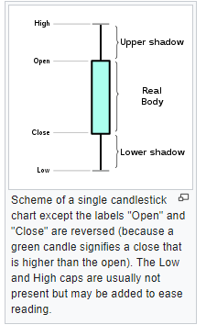
What is a candlestick.
A candlestick chart (also called Japanese candlestick chart) is a style of financial chart used to describe price movements of a security, derivative, or currency. Each "candlestick" typically shows one day, thus a one-month chart may show the 20 trading days as 20 candlesticks.Candlestick charts can also be built using intervals shorter or longer than one day.
It is similar to a bar chart in that each candlestick represents all four important pieces of information for that day: open and close in the thick body; high and low in the “candle wick”. Being densely packed with information, it tends to represent trading patterns over short periods of time, often a few days or a few trading sessions.
Candlestick charts are most often used in technical analysis of equity and currency price patterns.They are visually similar to box plots, though box plots show different information.

Slide 8
Types of candlesticks:

Slide 9
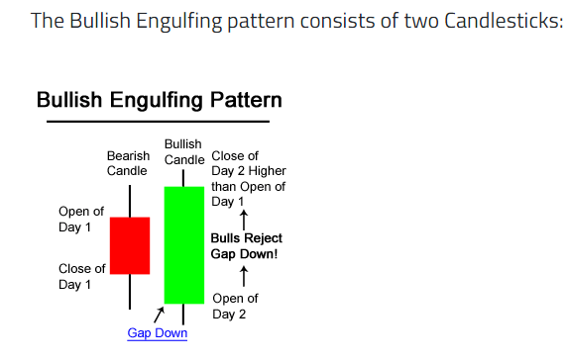
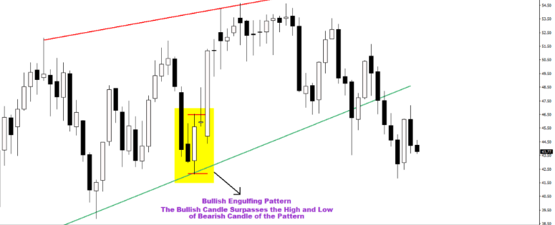
The Bullish Engulfing Candlestick Pattern is a bullish reversal pattern, usually occurring at the bottom of a downtrend. This quick introduction will teach you how to identify the pattern, and how traders use this in technical analysis.

Slide 10
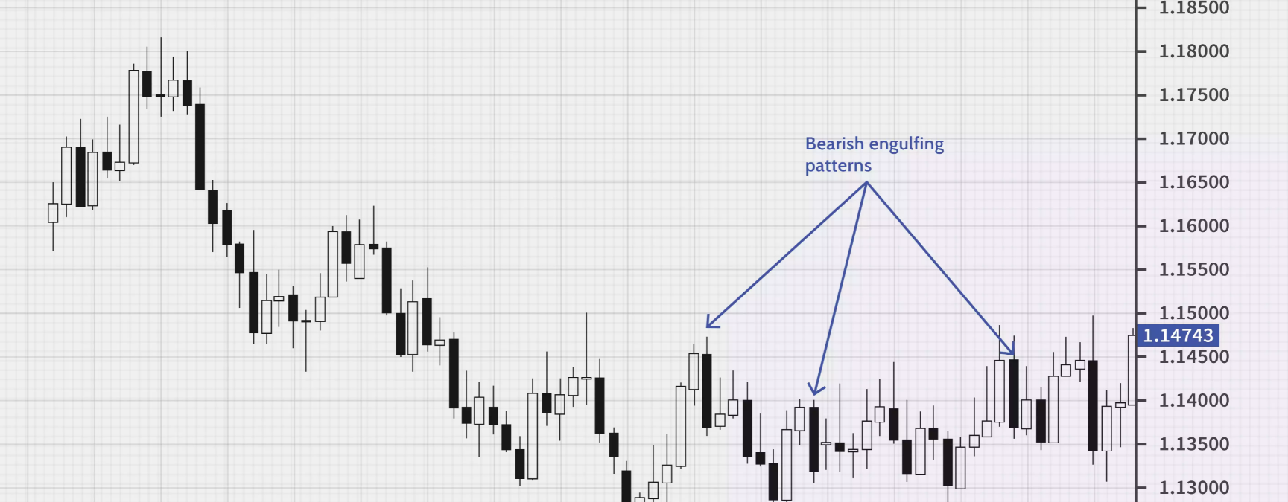
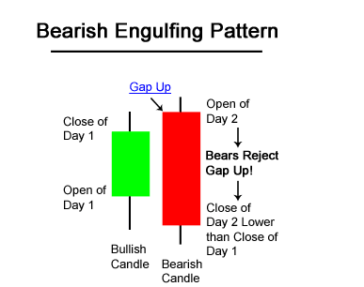
The Bearish Engulfing Candlestick Pattern is considered to be a bearish reversal pattern, usually occurring at the top of an uptrend.

Slide 11
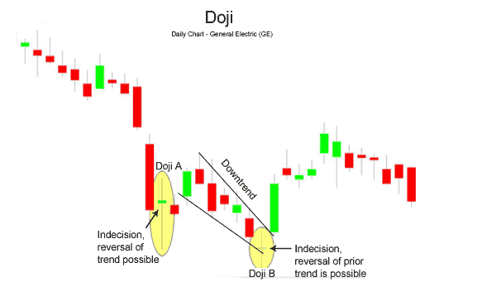
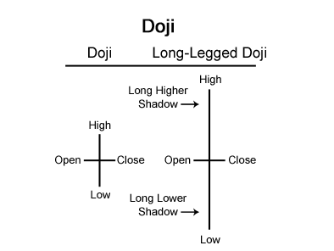
A doji is formed when the opening price and the closing price are equal. A long-legged doji, often called a “Rickshaw Man,” is the same as a doji, except the upper and lower shadows are much longer than the regular doji formation.
Doji candle

Slide 12
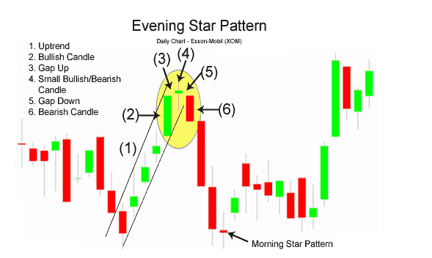
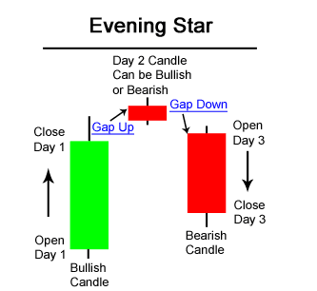
What is a timeframe.
The Evening Star pattern consists of three candlesticks: Large bullish candle (Day 1) Small bullish or bearish candle (Day 2) Large bearish candle (Day 3)

Slide 13
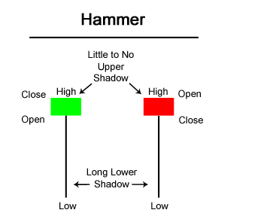
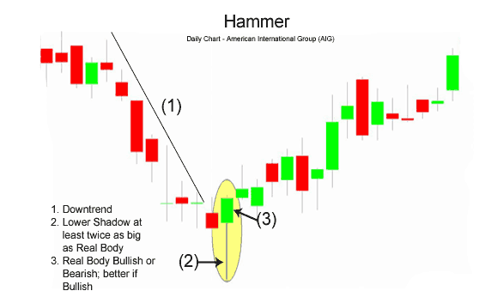
In this guide to understanding the Hammer Candlestick Formation, we’ll show you what this chart looks like, explain its components, teach you how to interpret it with an example, and discuss how to trade on a Hammer.
Hammer
What Is the Hammer Candlestick Formation? The Hammer candlestick formation is viewed as a bullish reversal candlestick pattern that mainly occurs at the bottom of downtrends. The Hammer helps traders visualize where support and demand are located. After a downtrend, the Hammer can signal to traders that the downtrend could be over and that short positions could potentially be covered.

Slide 14
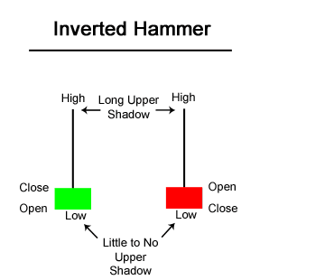
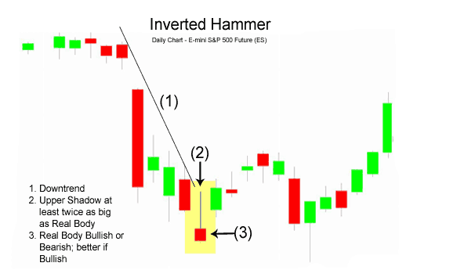
Inverted Hammer
What Is the Inverted Hammer Candlestick? The Inverted Hammer candlestick formation occurs mainly at the bottom of downtrends and can act as a warning of a potential bullish reversal pattern. What happens on the next day after the Inverted Hammer pattern is what gives traders an idea as to whether or not prices will go higher or lower. What Does the Inverted Hammer Look Like? The Inverted Hammer formation is created when the open, low, and close are roughly the same price. Also, there is a long upper shadow which should be at least twice the length of the real body.

Slide 15
Risk management:
What is forex risk management?
Forex risk management enables you to implement a set of rules and measures to ensure any negative impact of a forex trade is manageable. An effective strategy requires proper planning from the outset, since it’s better to have a risk management plan in place before you actually start trading.
What are the risks of forex trading?
Currency risk is the risk associated with the fluctuation of currency prices, making it more or less expensive to buy foreign assets
Interest rate risk is the risk related to the sudden increase or decrease of interest rates, which affects volatility. Interest rate changes affect FX prices because the level of spending and investment across an economy will increase or decrease, depending on the direction of the rate change
Liquidity risk is the risk that you can’t buy or sell an asset quickly enough to prevent a loss. Even though forex is a highly liquid market, there can be periods of illiquidity – depending on the currency and government policies around foreign exchange
Leverage risk is the risk of magnified losses when trading on margin. Because the initial outlay is smaller than the value of the FX trade, it’s easy to forget the amount of capital you are putting at risk
Use a stop loss for every trade you take.

Slide 16
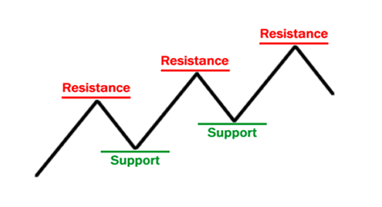
Support and resistance.(The structure of any trend)
“Support and resistance” is one of the most widely used concepts in forex trading.
Strangely enough, everyone seems to have their own idea of how you should measure support and resistance.

Slide 17
Look at the diagram above. As you can see, this zigzag pattern is making its way up (a “bull market”).
When the price moves up and then pulls back, the highest point reached before it pulled back is now resistance.
Resistance levels indicate where there will be a surplus of sellers.
When the price continues up again, the lowest point reached before it started back is now support.
Support levels indicate where there will be a surplus of buyers.
In this way, resistance and support are continually formed as the price moves up and down over time.
The reverse is true during a downtrend.

Slide 18
In the most basic way, this is how support and resistance are normally traded:
Trade the “Bounce”
Buy when the price falls towards support.
Sell when the price rises towards resistance.
Trade the “Break”
Buy when the price breaks up through resistance.
Sell when the price breaks down through support.
A “bounce” and “break”? We will cover these concepts in more detail later.

Slide 19
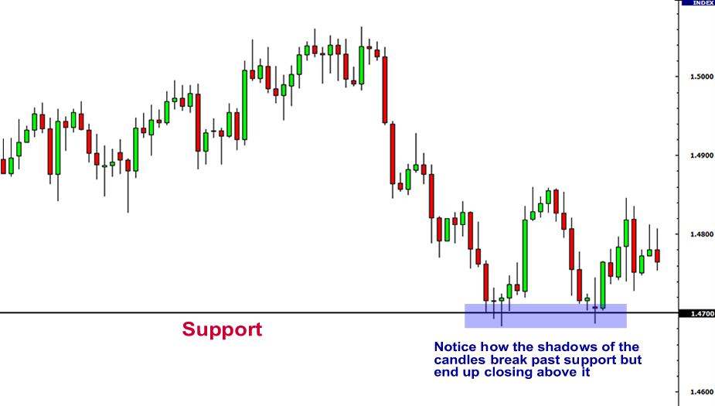
Plotting Support and Resistance Levels
One thing to remember is that support and resistance levels are not exact numbers.
Often times you will see a support or resistance level that appears broken, but soon after find out that the market was just testing it.
With candlestick charts, these “tests” of support and resistance are usually represented by the candlestick shadows.

Slide 20
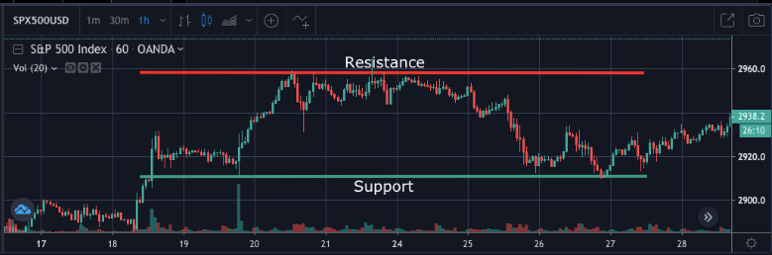
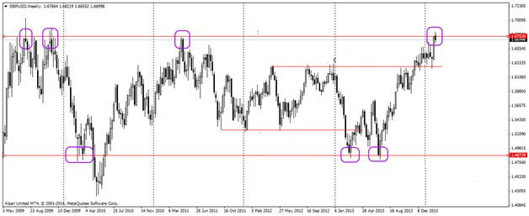
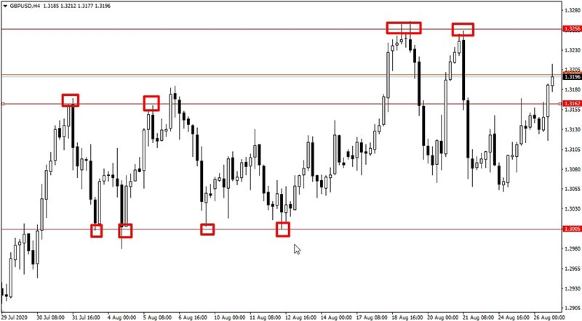
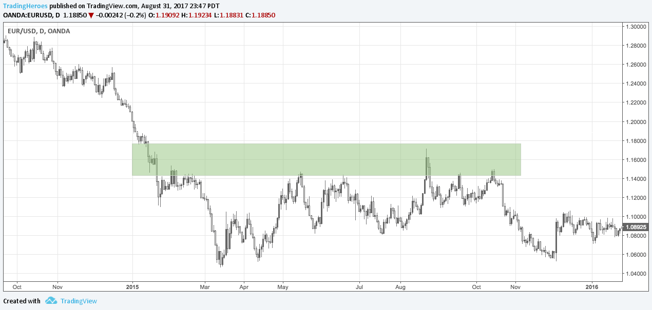

Slide 21
Stop losses for support and resistance.
When a structural level is identified,place your stop loss 20-40 pips away from the entry,depending on the timeframe you are trading on.The larger the timeframe,the wider the stop loss should be.

Slide 22
Breakouts

Slide 23
Breakouts:
What are Forex Breakouts?
We have a breakout when the price of a Forex pair overpowers and eventually breaks out of a specific psychological level. When you look at the price behavior on a chart, you will notice that the prices typically tend to move within and conform to specific levels.
When you see the price hitting a level and quickly reverse, we consider this as an important clue about the strength of the level. And so when price comes back to retest that level, we have to watch price action closely and anticipate a potential breakout or rejection trade setup.
Sometimes, you might see the price hitting the same level a few times. This means that the particular level may be stronger than usual. However the price will eventually break thru any contained levels at some point. This is when we have a breakout trading setup.

Slide 24
Why Trade Forex Breakouts?
Breakout trading setups in Forex can provide nice trading opportunities. The reason for this is that breakouts often lead to new price moves and trends. In this manner, traders attempt to enter the market right when a breakout occurs in order to get in early on a potential emerging trend.
In addition, many of the more reliable breakouts tend to occur on high momentum, and price action traders attempt to maximize their profit from the rapid price moves. Breakout trading is a simple and popular trading technique used by many Forex traders for good reason.
Where Do Breakouts Occur?
Breakouts occur on psychological price levels. These could be:
Supports or Resistance
Time Highs or Lows
Trend Lines
Price Channels
Moving Averages
Chart Pattern Levels
Fibonacci Levels

Slide 25
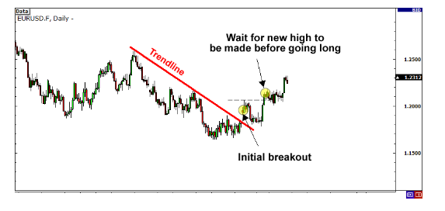
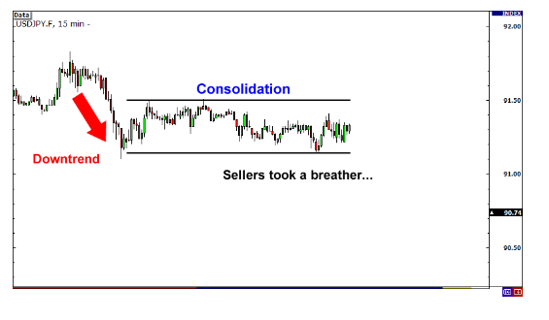
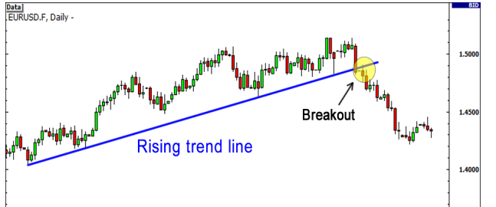
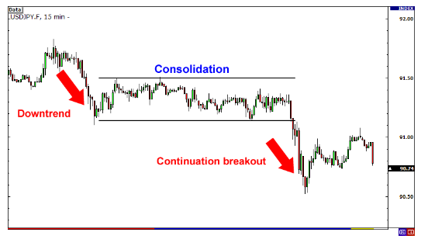
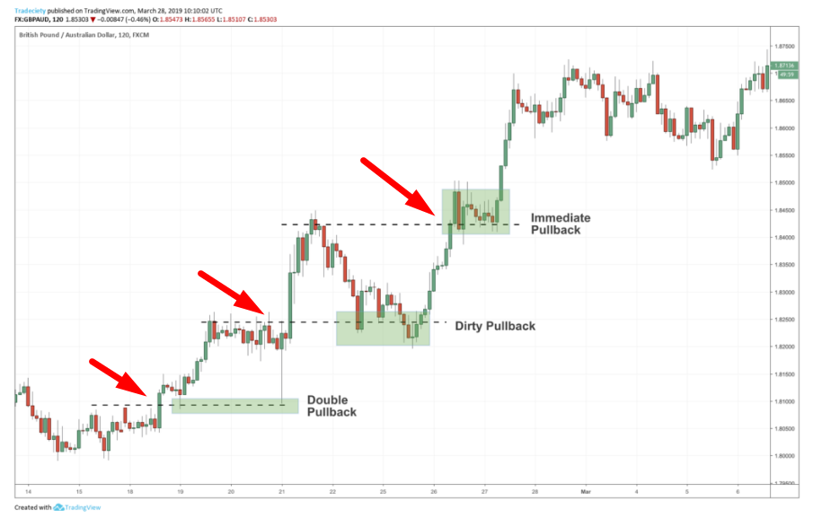

Slide 26
Conclusion
A breakout trading method is an effective way to enter the market in the beginning of an emerging price move.
We have a valid breakout when the price breaks and closes beyond a psychological level on the chart
A psychological level should not be marked with a single thin line. We should perceive psychological levels as zones rather than an exact area marked by a fixed line.
We have a breakout whenever the price closes a candle beyond that psychological area.
If you want to get an additional confirmation you can use these 4 simple steps to identify real breakouts:
The price closes a candle beyond a psychological level.
The price creates a top (or bottom if the breakout is bearish) after the break.
The price returns to test the already broken resistance as a support (or the opposite if it is a bearish breakout).
The price bounces and breaks the already created top (or bottom if the breakout is bearish).
If your price action rules are not sufficient for you to confirm a breakout, you can always use an additional trading indicator. A good indicator for confirming breakouts is the Momentum Indicator.
In order to exit the market after a breakout trade you can use price action techniques, or another trading indicator. The moving average is an effective indicator to use for taking profits when trading breakouts.

Slide 27
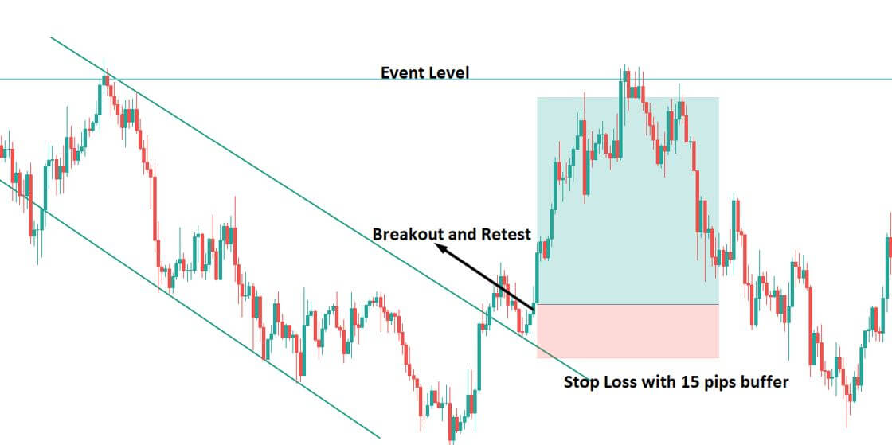
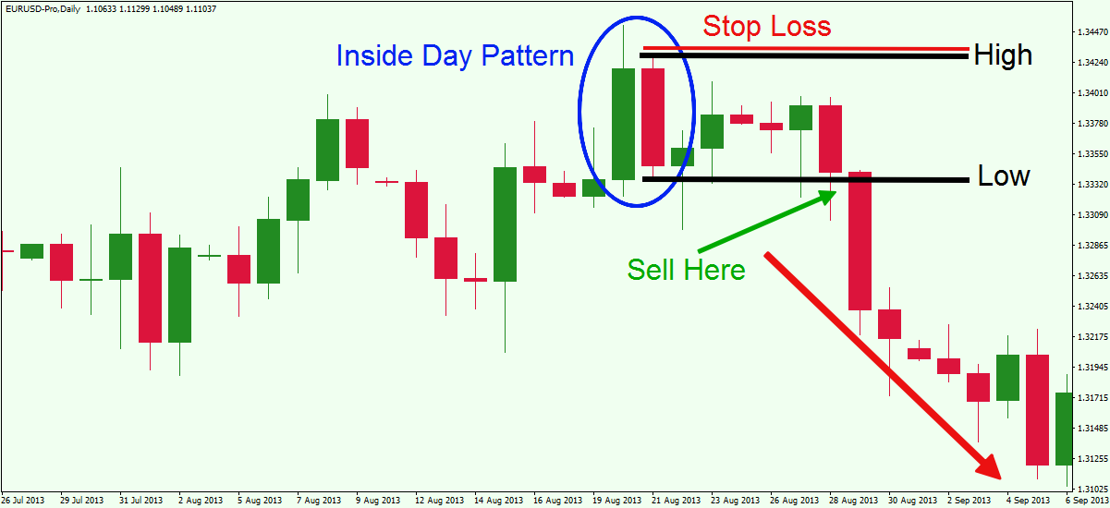
Stop losses for breakouts.

Slide 28
Understanding Price action in trading Forex
The first critical step to understanding the market structure like a pro is plotting key Support and Resistance (S&R) on the chart. The reason is straightforward: the price will often respect, stop, or reverse at these S&R zones. This tends to happen especially when:
There is confluence of levels at or near a price zone.
The price is approaching a respected and recent S&R level for the first or even second time.
Traders need to be aware of the major price zones to avoid trading into keys levels and perhaps even be prepared to trade away from those levels (i.e., taking a long at support if higher time frames are in an uptrend).
Key S&R levels can be very diverse, and, ultimately, it's up to each trader to show the preferred tools. Keep in mind that adding too many S&R levels, however, will clutter the chart.

Slide 29
Trendlines and how to use them.
Trend lines are probably the most common form of technical analysis in forex trading.
They are probably one of the most underutilized ones as well.
If drawn correctly, they can be as accurate as any other method.
Unfortunately, most forex traders don’t draw them correctly or try to make the line fit the market instead of the other way around. In their most basic form, an uptrend line is drawn along the bottom of easily identifiable support areas (valleys).
This is known as an ascending trend line.
In a downtrend, the trend line is drawn along the top of easily identifiable resistance areas (peaks).
This is known as a descending trend line.
How do you draw trend lines?
To draw forex trend lines properly, all you have to do is locate two major tops or bottoms and connect them.

Slide 30
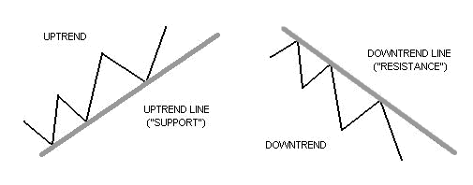

Slide 31
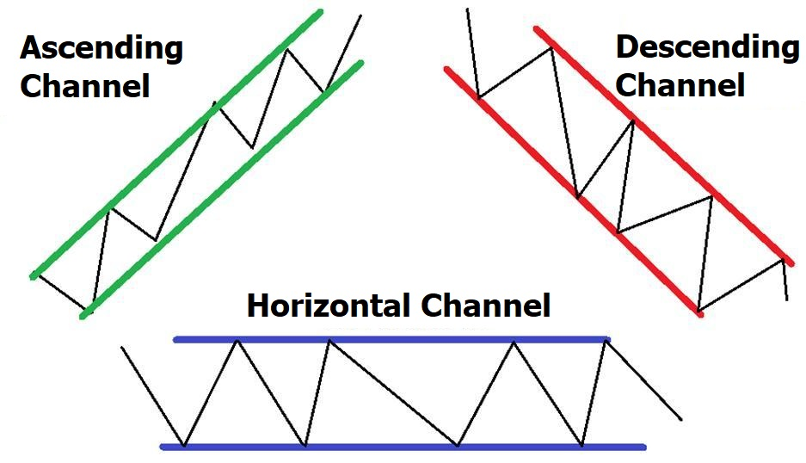
Trend channels.
If we take this trend line theory one step further and draw a parallel line at the same angle of the uptrend or downtrend, we will have created a channel.
No, we’re not talking about ESPN, National Geographic Channel, or Cartoon Network.
These channels aren’t television channels, they’re trend channels, sometimes also called price channels.
Still, this doesn’t mean that you should walk away like it’s a commercial break. Channels can be just as exciting to watch as Tiger King or Keeping Up with the Kardashians!
Trend channels are just another tool in technical analysis which can be used to determine good places to buy or sell.
The upper trend line marks resistance and the lower trend line marks support. So both the tops and bottoms of channels represent potential areas of support or resistance.
Trend channels with a negative slope (down) are considered bearish and those with a positive slope (up) are considered bullish.

Slide 32
To create an up (ascending) channel, simply draw a parallel line at the same angle as an uptrend line and then move that line to position where it touches the most recent peak. This should be done at the same time you create the trend line.
To create a down (descending) channel, simply draw a parallel line at the same angle as the downtrend line and then move that line to a position where it touches the most recent valley. This should be done at the same time you create the trend line.
When prices hit the LOWER trend line, this may be used as a buying area.
When prices hit the UPPER trend line, this may be used as a selling area.

Slide 33
Types of trend channels.
Types of Trend Channels
There are three types of channels:
Ascending channel (higher highs and higher lows)
Descending channel (lower highs and lower lows)
Horizontal channel (ranging)
Some traders prefer to use the terms “rising channel” for an ascending channel and “falling channel” for a descending channel. Most likely, Millenials.
Important things to remember about drawing trend channels:
When constructing a trend channel, both trend lines must be parallel to each other.
Generally, the bottom of the trend channel is considered a “buy zone” while the top of the trend channel is considered a “sell zone”.
Like in drawing trend lines, DO NOT EVER force the price to the channels that you draw!
A channel boundary that is sloping at one angle while the corresponding channel boundary is sloping at a different angle is not correct and could lead to bad trades.
When this happens, this chart pattern is no longer a trend channel but a triangle. (which you will learn about more later).
That said, trend channels don’t have to be completely parallel. Nor does 100% of price action have to fit within the channel.
A common mistake many traders make is that they only look for textbook price patterns.
They miss important information about price action and close their eyes to other important clues.
Notice the channel drawings below…

Slide 34
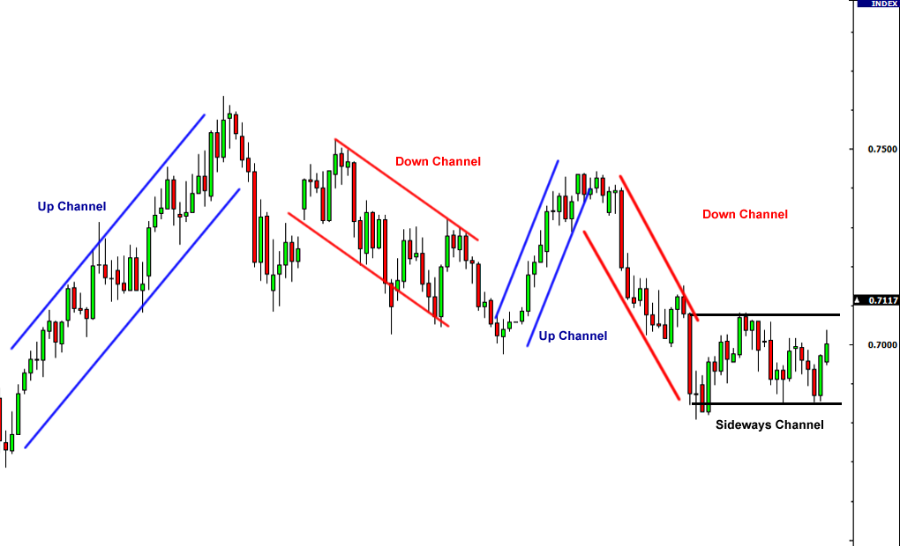

Slide 35
Risk management

Slide 36
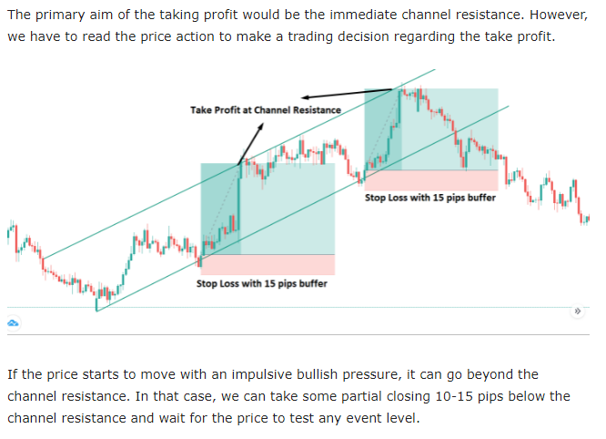
Stop losses , when trading uptrend channels

Slide 37
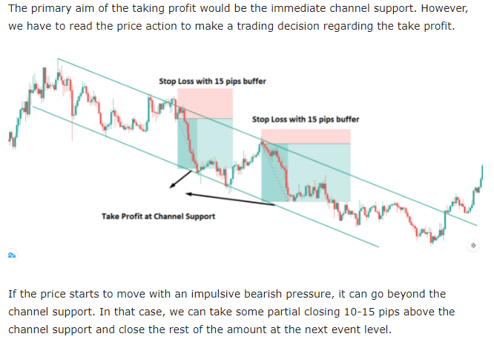
Stop losses when trading downtrend channels

Slide 38
Approach to fundamental analysis:

Slide 39
FUNDAMENTAL ANALYSIS
Equities or commodities are valued by their intrinsic strength on an absolute basis, while foreign exchange is valued by the relative strength of one currency with respect to another. Some of the economic indicators that fall into the realm of fundamental analysis are interest rates, employment reports, and inflation reports, among others.
WHAT IS FUNDAMENTAL ANALYSIS?
Trading on the fundamentals – also referred to as trading the news – is the study of news events and economic statistics to determine trading opportunities. Referred to as fundamentalists, these traders pay close attention to changes in economic indicators such as interest rates, employment rates, and inflation.

Slide 40
